Slide 1
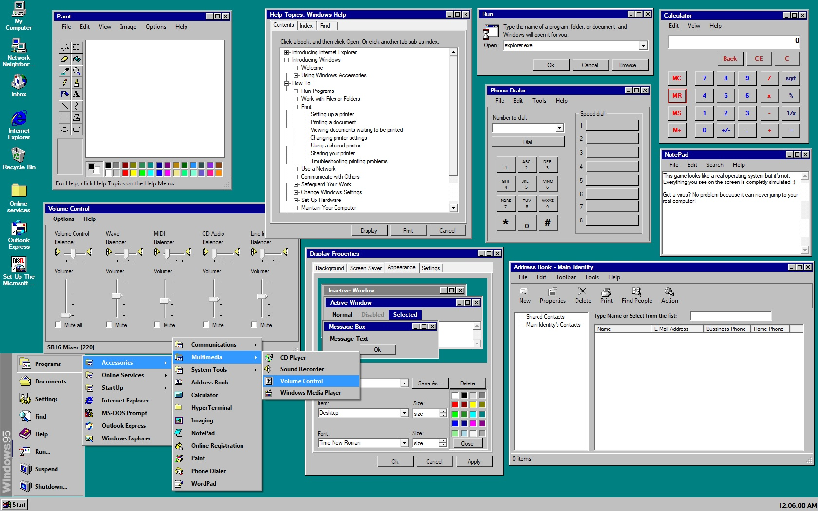
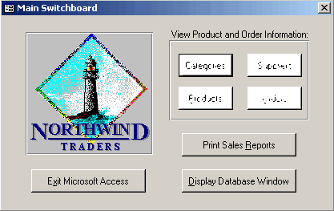
Hypothesis 1
Hypothesis 2
Hypothesis 3
Hypothesis4
Notes:
The obvious buttons are clickable, and some of the others are as well. The large Nortwind Traders goes to github repo. All other hypotheses tests go to the correct slide. Ignore clippy, he never helps.

Slide 2


Do discounts have a statistically significant effect on the number of products customers order? If so, at what level(s) of discount?
Null Hypothesis The number of products customers order is not related to the level of discount
Alternative Hypothesis The number of products customers order is related to the level of discount.
Effect Size Numbers of products ordered at the 5%, 10%, 15%, 20%, 25% levels of discount.
Variables We Are Interested in Determining the Relationship Between Number of products ordered and percent discount

Slide 3
Do discounts have a statistically significant effect on the number of products customers order? If so, at what level(s) of discount?
99.999999936 % Chance of increase in quantities ordered because of discount

Slide 4
Do discounts have a statistically significant effect on the number of products customers order? If so, at what level(s) of discount?
0% =18 items/order
5% = 28 items/order
10%= 25 items/order
15%= 28 items/order
20%= 27 items/order
25%= 28 items/order

Slide 5
Is the company spending more on shipping each year?
Null Hypothesis The cost of freight has no relationship with the year.
Alternative Hypothesis The freight cost is related to the year in which order was shipped.
Effect Size We are looking for a more than 5% difference in freight cost.
Variables We Are Interested in Determining the Relationship Between Freight cost and year.

Slide 6

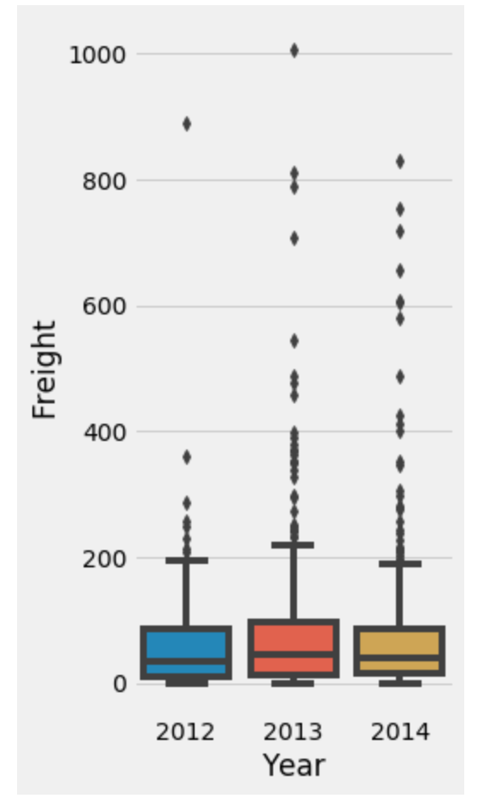
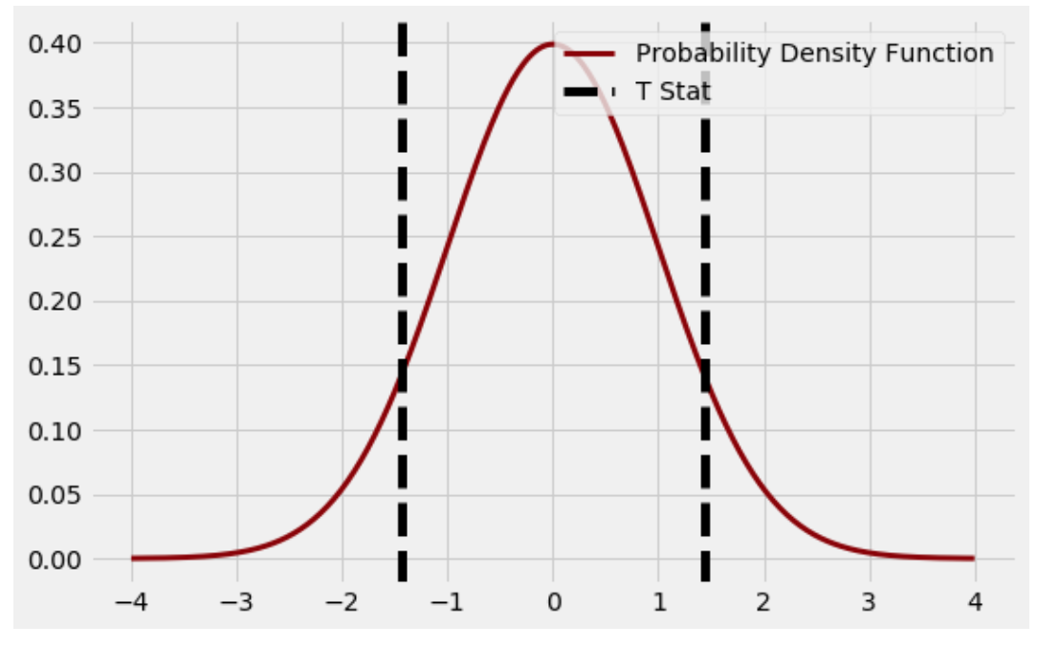
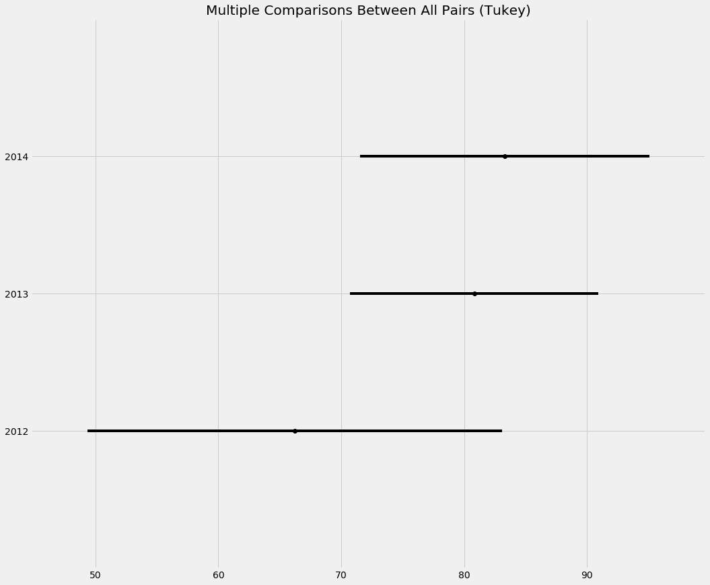
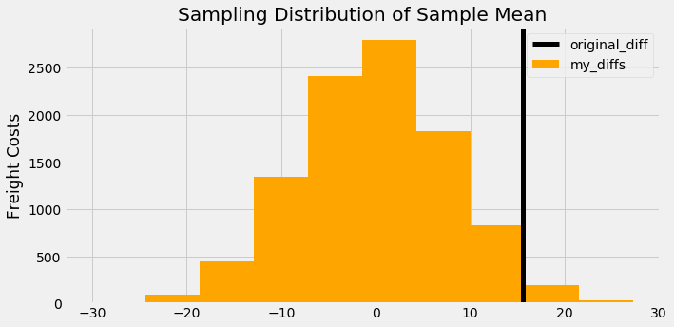
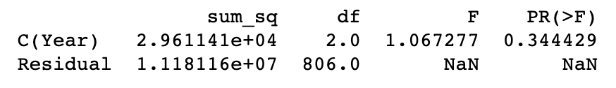
Is the company spending more on shipping each year?
Unable to Reject the Null Hypothesis
No Correlation Between Year and Freight Cost

Slide 7
Cost of delivery
While there were a few more expensive delivery fees in 2013 and 2014 the majority were nearly identical

Slide 8

Notice the overlap from year to year

Slide 9
There is no correlation
The data does not support our idea that price of shipping is dependent upon the year it was shipped
P-value = 0.151

Slide 10
Is the cost of shipping related to the shipment company?
Null Hypothesis All delivery companies cost the same.
Alternative Hypothesis The delivery companies cost more or less than one another
Effect Size I was looking for at least a 5% difference from one company to another.
Variables We Are Interested in Determining the Relationship Between Shipping company and freight cost.

Slide 11
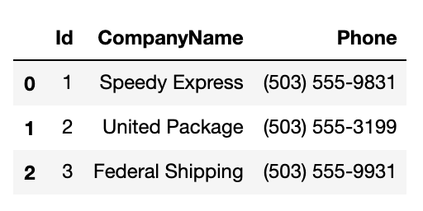

Slide 12
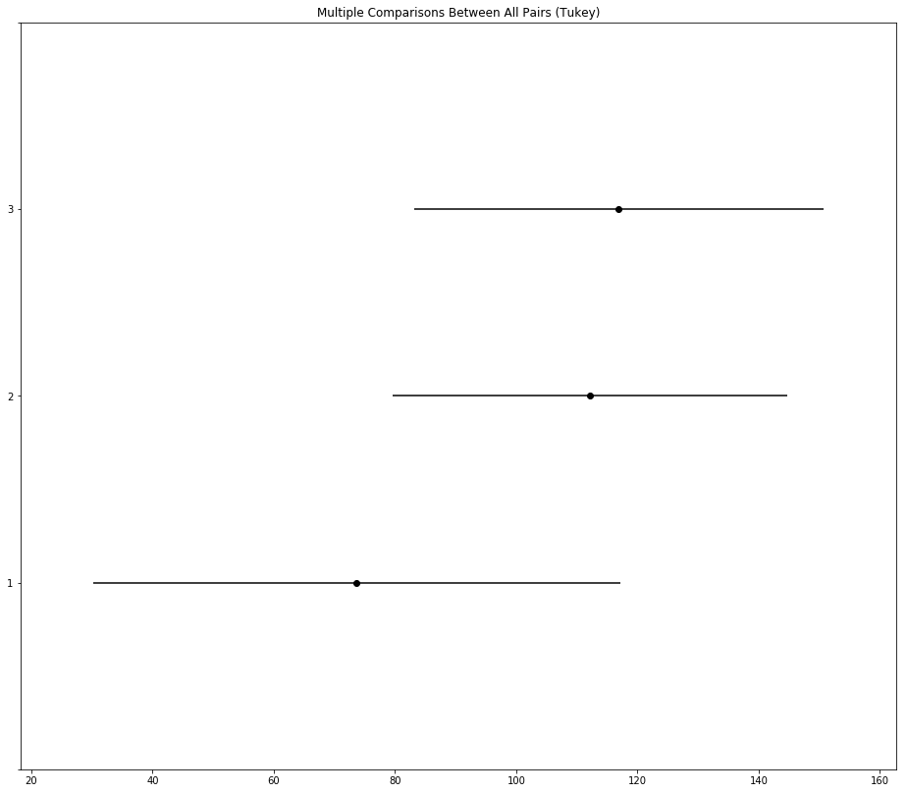
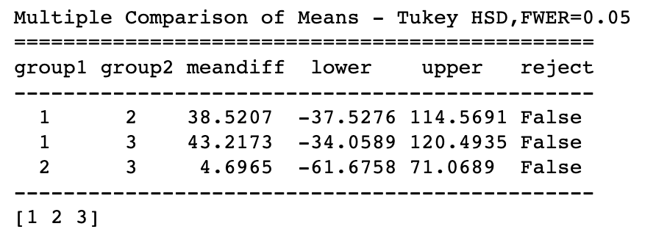
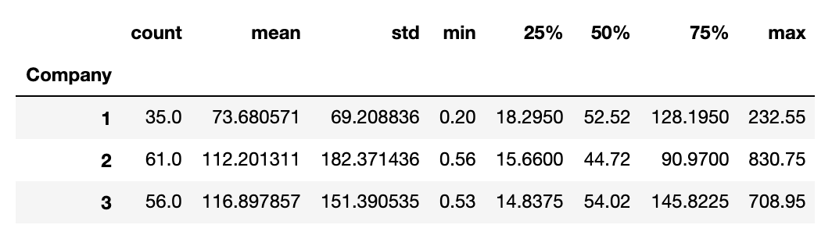
Comparing average shipping cost
Notice the overlap
While Speedy had some of the lowest costs there is not enough evidence to say this was anything but a coincidence.

Slide 13
Do Different Regions Spend More/Less on the average order?
Null Hypothesis All Geographic Regions Spend the same per order
Alternative Hypothesis Certain Regions spend more or less than others
Effect Size Looking for a difference of at least 5%
Variables We Are Interested in Determining the Relationship Between
Cost of order and geographic region

Slide 14
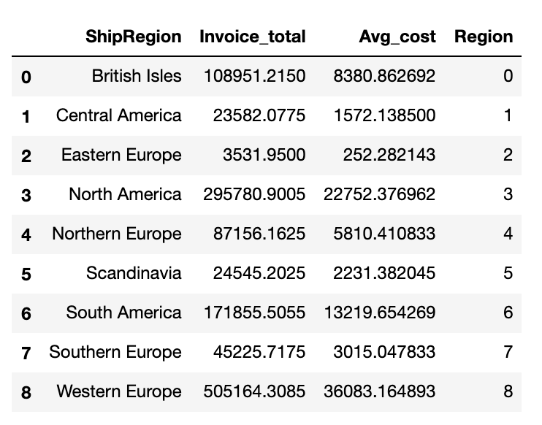
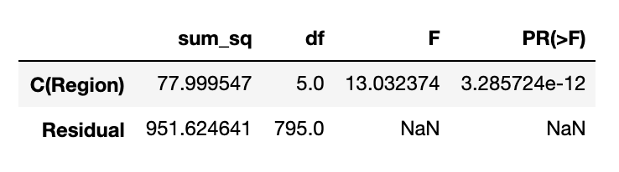
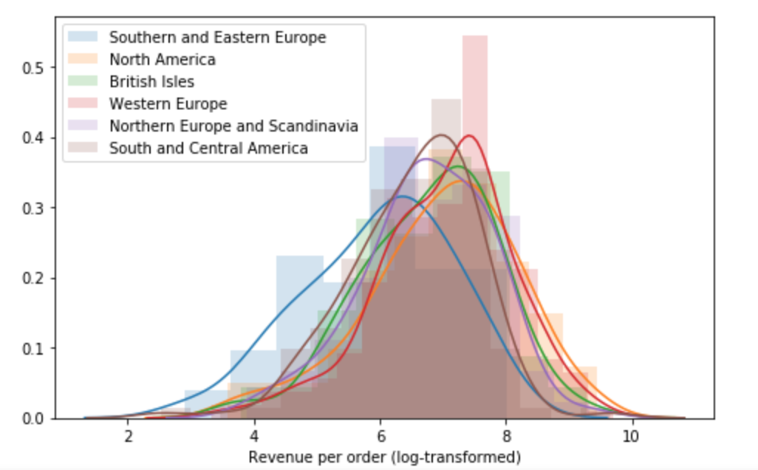
There is a significant difference! Next steps would be to determine which regions create the most/least revenue.

Slide 15

Next Steps
While some of the hypothesis tests were a bit ridiculous due to the fictitious nature of the data. The following slides contain some potential next steps to take.

Slide 16
Next Steps
Determine buyers relationship with discount and quantity ordered
Determine Northwind Trader’s Net Income with and without discount
At what discount percentage does Northwind make the most money after overhead?
Determine net income for different types of products at different discount percentages.
How profitable are different categories of products at different discount levels
Categorize similar buyers/clients
Clients who bought similar items
Clients in similar business
Clients in same geographic location
Run Hypothesis Test again
Do certain types of clients respond differently to discounts?

Slide 17
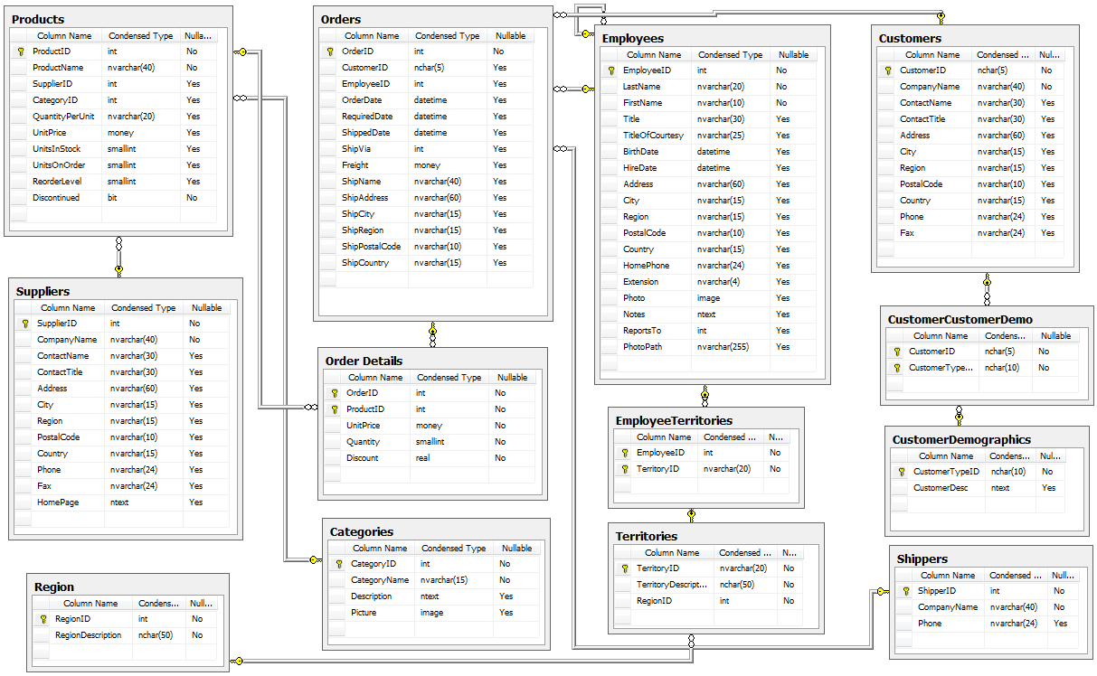
The Northwind Trading Company
The Northwind database is a sample database used by Microsoft to demonstrate the features of some of its products, including SQL Server and Microsoft Access. The database contains the sales data for Northwind Traders, a fictitious specialty foods export/import company.

